Slide 1
5.7 – Pythagorean Theorem
Pythagorean Inequalities Theorem

Slide 2
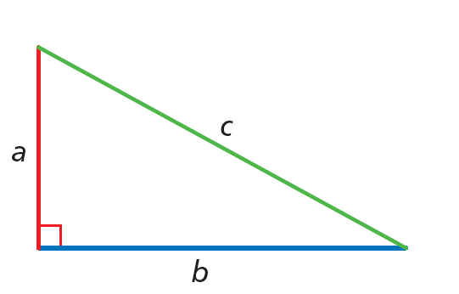
The converse of the Pythagorean Theorem gives you a way to tell if a triangle is a right triangle when you know the side lengths.
Converse of Pythagorean Theorem:
If , then it is a RIGHT TRIANGLE.

Slide 3
You can also use side lengths to classify a triangle as acute or obtuse.
B
c
a
A
C
b

Slide 4
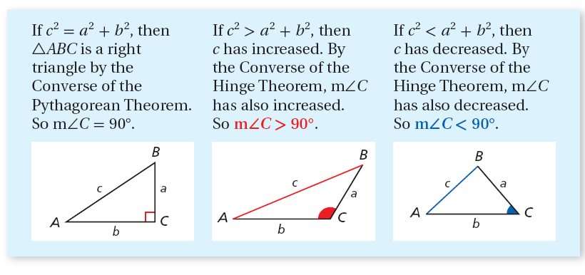
To understand why the Pythagorean inequalities are true, consider ∆ABC.

Slide 5
Remember!
By the Triangle Inequality Theorem, the sum of any two side lengths of a triangle is greater
than the third side length.

Slide 6
Example 4A: Classifying Triangles
Tell if the measures can be the side lengths of a triangle. If so, classify the triangle as acute, obtuse, or right.
5, 7, 10
Step 1 Determine if the measures form a triangle.
By the Triangle Inequality Theorem, 5, 7, and 10 can be the side lengths of a triangle.

Slide 7
Example 4A Continued
Step 2 Classify the triangle.
?
c² = a² + b²
Compare c² to a² + b².
?
10² = 5² + 7²
Substitute the longest side for c.
?
100 = 25 + 49
Multiply.
100 > 74
Add and compare.
Since c² > a² + b², the triangle is obtuse.

Slide 8
Example 4B: Classifying Triangles
Tell if the measures can be the side lengths of a triangle. If so, classify the triangle as acute, obtuse, or right.
5, 8, 17
Step 1 Determine if the measures form a triangle.
Since 5 + 8 = 13 and 13 > 17, these cannot be the side lengths of a triangle.

Slide 9
Check It Out! Example 4b
Tell if the measures can be the side lengths of a triangle. If so, classify the triangle as acute, obtuse, or right.
11, 18, 34
Step 1 Determine if the measures form a triangle.
Since 11 + 18 = 29 and 29 > 34, these cannot be the sides of a triangle.

Slide 10
Check It Out! Example 4c
Tell if the measures can be the side lengths of a triangle. If so, classify the triangle as acute, obtuse, or right.
3.8, 4.1, 5.2
Step 1 Determine if the measures form a triangle.
By the Triangle Inequality Theorem, 3.8, 4.1, and 5.2 can be the side lengths of a triangle.

Slide 11
Check It Out! Example 4c Continued
Step 2 Classify the triangle.
?
c² = a² + b²
Compare c² to a² + b².
?
5.2² = 3.8² + 4.1²
Substitute the longest side for c.
?
27.04 = 14.44 + 16.81
Multiply.
27.04 < 31.25
Add and compare.
Since c² < a² + b², the triangle is acute.

Slide 12
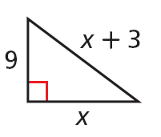
Lesson Quiz: Part I
1. Find the value of x.
2. An entertainment center is 52 in. wide and 40 in. high. Will a TV with a 60 in. diagonal fit in it? Explain.
12

Slide 13
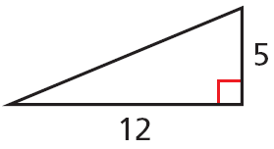
Lesson Quiz: Part II
3. Find the missing side length. Tell if the side lengths form a Pythagorean triple. Explain.
4. Tell if the measures 7, 11, and 15 can be the side lengths of a triangle. If so, classify the triangle as acute, obtuse, or right.
13; yes; the side lengths are nonzero whole numbers that satisfy Pythagorean’s Theorem.
yes; obtuse

Slide 14
Homework
Page 352 #9-11, 19-24, 30, 32, 38-40

