Slide 1
5.7 – Pythagorean Theorem
Finding Side Lengths/ Finding Perimeter / Pythagorean Triples

Slide 2
Simplifying Radical Expressions
On Your Own….

Slide 3
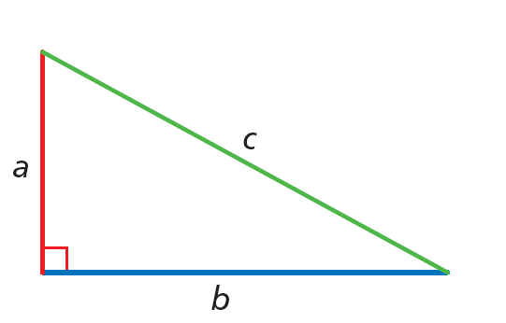
Pythagorean Theorem
a² + b² = c²

Slide 4
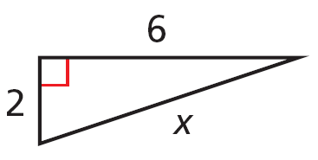
Pythagorean Theorem

Slide 5
Pythagorean Theorem

Slide 6
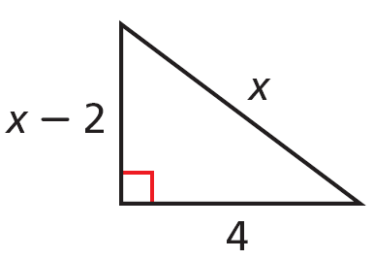
Pythagorean Theorem
5 = x

Slide 7
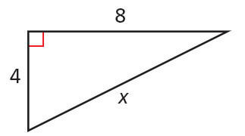
Pythagorean Theorem

Slide 8
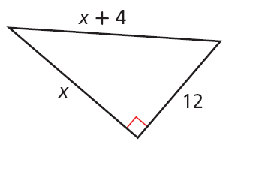
Pythagorean Theorem
16 = x

Slide 9
Pythagorean Theorem
A set of three nonzero whole numbers a, b, and c such that a² + b² = c² is called a Pythagorean triple.

Slide 10
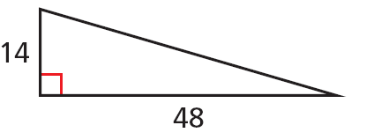
Pythagorean Theorem
Find the missing side length. Tell if the side lengths form a Pythagorean triple. Explain.
50 = c

Slide 11
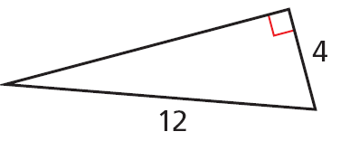
Pythagorean Theorem
Find the missing side length. Tell if the side lengths form a Pythagorean triple. Explain.

Slide 12
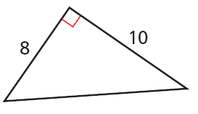
Pythagorean Theorem
Find the missing side length. Tell if the side lengths form a Pythagorean triple. Explain.

Slide 13
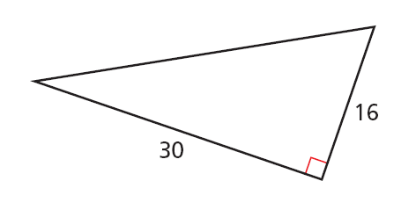
Pythagorean Theorem
Find the missing side length. Tell if the side lengths form a Pythagorean triple. Explain.
c = 34

Slide 14
HOMEWORK
Page 352 # 2-4, 6-8, 15-17

