Slide 1
Warm Up
Determine the coordinates of the image of P(4, –7) under each transformation.
1. a translation 3 units left and 1 unit up
(1, –6)
2. a rotation of 90° about the origin
(7, 4)
3. a reflection across the y-axis
(–4, –7)

Slide 2
12.4-12.5 Compositions of Transformations and 2D Symmetry

Slide 3
A composition of transformations is one transformation followed by another.
Ex: Glide Reflection

Slide 4
The glide reflection that maps ∆JKL to ∆J’K’L’ is the composition of a translation along followed by a reflection across line l.

Slide 5
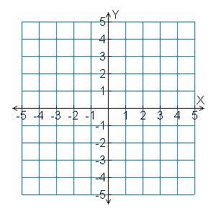
Example 1B: Drawing Compositions of Isometries
Draw the result of the composition of isometries.
∆KLM has vertices K(4, –1), L(5, –2), and M(1, –4). Rotate ∆KLM 180° about the origin and then reflect it across the y-axis.
K
L
M

Slide 6
Example 1B Continued
Step 1 The rotational image of (x, y) is (–x, –y).
M’
M”
K(4, –1) → K’(–4, 1),
L(5, –2) → L’(–5, 2), and
M(1, –4) → M’(–1, 4).
L’
L”
K’
K”
Step 2 The reflection image of (x, y) is (–x, y).
K
L
K’(–4, 1) → K”(4, 1),
L’(–5, 2) → L”(5, 2), and M’(–1, 4) → M”(1, 4).
M
Step 3 Graph the image and preimages.

Slide 7
Lesson Quiz: Part I
PQR has vertices P(5, –2), Q(1, –4), and P(–3, 3).
1. Translate ∆PQR along the vector <–2, 1> and then reflect it across the x-axis.
P”(3, 1), Q”(–1, –5), R”(–5, –4)
2. Reflect ∆PQR across the line y = x and then rotate it 90° about the origin.
P”(–5, –2), Q”(–1, 4), R”(3, 3)

Slide 8
A figure has symmetry if there is a transformation of the figure such that the image coincides with the preimage.
Line symmetry (reflection symmetry) – if a figure can be reflected across a line so that it coincides with the preimage.
The Line of symmetry should divide the figure into two congruent halves

Slide 9
Example 1A: Identifying line of symmetry
Tell whether the figure has line symmetry. If so, copy the shape and draw all lines of symmetry.
yes; eight lines of symmetry

Slide 10
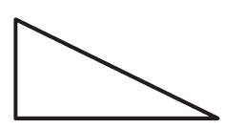
Example 1B: Identifying line of symmetry
Tell whether the figure has line symmetry. If so, copy the shape and draw all lines of symmetry.
no line symmetry

Slide 11
Example 1C: Identifying line of symmetry
Tell whether the figure has line symmetry. If so, copy the shape and draw all lines of symmetry.
Yes; four lines of symmetry

Slide 12
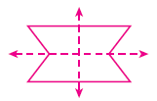
Check It Out! Example 1
Tell whether each figure has line symmetry. If so, copy the shape and draw all lines of symmetry.
a.
yes; two lines of symmetry
yes; one line of symmetry
b.
c.
yes; one line of symmetry

Slide 13
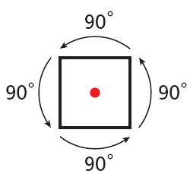
Rotational symmetry (radial symmetry) – if a figure can be rotated about a point, so that the image looks exactly like the preimage
angle of rotational symmetry is the smallest angle through which a figure can be rotated to look like the preimage
Order - The number of times you rotate it to get it back to the original

Slide 14
Example 2: Identifying Rotational Symmetry
Tell whether each figure has rotational symmetry. If so, give the angle of rotational symmetry and the order of the symmetry.
A.
no rotational symmetry
B.
yes; 180°; order: 2
C.
yes; 90°;
order: 4

Slide 15
Check It Out! Example 2
Tell whether each figure has rotational symmetry. If so, give the angle of rotational symmetry and the order of the symmetry.
a.
b.
c.
yes; 120°; order: 3
yes; 180°; order: 2
no rotational symmetry

Slide 16
Example 3A: Design Application
Describe the symmetry of each icon. Copy each shape and draw any lines of symmetry. If there is rotational symmetry, give the angle and order.
No line symmetry; rotational symmetry; angle of rotational symmetry: 180°; order: 2

Slide 17
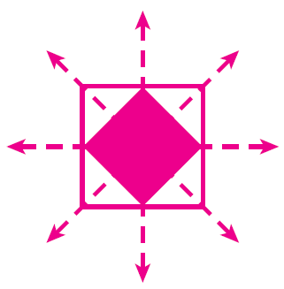
Example 3B: Design Application
Describe the symmetry of each icon. Copy each shape and draw any lines of symmetry. If there is rotational symmetry, give the angle and order.
Line symmetry and rotational symmetry;
angle of rotational symmetry: 90°; order: 4

Slide 18
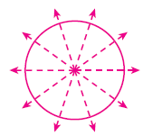
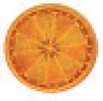
Check It Out! Example 3
Describe the symmetry of each diatom. Copy the shape and draw any lines of symmetry. If there is rotational symmetry, give the angle and order.
a.
b.
line symmetry and rotational symmetry; 72°; order: 5
line symmetry and rotational symmetry; 51.4°; order: 7

Slide 19
HOMEWORK:
Pg. 851 #4, 10
Pg. 859 # 3-9

