Slide 1
Warm Up
Given that ∆ABC ≅ ∆DEF, identify a segment or angle congruent to each of the following.
1.
2.
3.
4.
5.
6.

Slide 2
Objective
Identify and draw reflections.

Slide 3
An isometry is a transformation that does not change the shape or size of a figure. Reflections, translations, and rotations are all isometries. Isometries are also called congruence transformations or rigid motions.
Reflection- a transformation that moves a figure (the preimage) by flipping it across a line. The reflected figure is called the image. A reflection is an isometry, so the image is always congruent to the preimage.

Slide 4
Example 1: Identifying Reflections
Tell whether each transformation appears to be a reflection. Explain.
A.
B.
No; the image does not
Appear to be flipped.
Yes; the image appears to be flipped across a line..

Slide 5
Check It Out! Example 1
Tell whether each transformation appears to be a reflection.
a.
b.
No; the figure does not appear to be flipped.
Yes; the image appears to be flipped across a line.

Slide 6
Draw a segment from each vertex of the preimage to the corresponding vertex of the image. Your construction should show that the line of reflection is the perpendicular bisector of every segment connecting a point and its image.

Slide 8
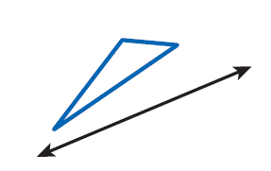
Example 2: Drawing Reflections
Copy the triangle and the line of reflection. Draw the reflection of the triangle across the line.
Step 1 Through each vertex draw a line perpendicular to the line of reflection.

Slide 9
Example 2 Continued
Step 2 Measure the distance from each vertex to the line of reflection. Locate the image of each vertex on the opposite side of the line of reflection and the same distance from it.

Slide 10
Example 2 Continued
Step 3 Connect the images of the vertices.

Slide 11
Check It Out! Example 2
Copy the quadrilateral and the line of reflection. Draw the reflection of the quadrilateral across the line.

Slide 13
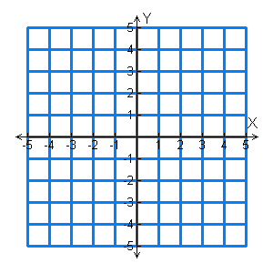
Example 4A: Drawing Reflections in the Coordinate Plane
Reflect the figure with the given vertices across the given line.
X(2, –1), Y(–4, –3), Z(3, 2); x-axis
The reflection of (x, y) is (x,–y).
Y’
X(2,–1) X’(2, 1)
Z
X’
Y(–4,–3) Y’(–4, 3)
X
Z(3, 2) Z’(3, –2)
Z’
Y
Graph the image and preimage.

Slide 14
Example 4B: Drawing Reflections in the Coordinate Plane
Reflect the figure with the given vertices across the given line.
R(–2, 2), S(5, 0), T(3, –1); y = x
S’
The reflection of (x, y) is (y, x).
R(–2, 2) R’(2, –2)
T’
R
S(5, 0) S’(0, 5)
T(3, –1) T’(–1, 3)
S
T
Graph the image and preimage.
R’

Slide 15
Check It Out! Example 4
Reflect the rectangle with vertices S(3, 4),
T(3, 1), U(–2, 1) and V(–2, 4) across the x-axis.
The reflection of (x, y) is (x,–y).
S(3, 4) S’(3, –4)
V
S
T(3, 1) T’(3, –1)
U(–2, 1) U’(–2, –1)
U
T
U’
T’
V(–2, 4) V’(–2, –4)
Graph the image and preimage.
V’
S’

Slide 16
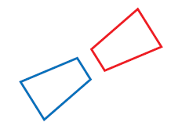
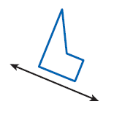
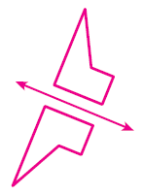
Lesson Quiz: Part I
1. Tell whether the transformation appears to be a reflection.
yes
2. Copy the figure and the line of reflection. Draw the reflection of the figure across the line.

Slide 17
Lesson Quiz: Part II
Reflect the figure with the given vertices across the given line.
3. A(2, 3), B(–1, 5), C(4,–1); y = x
A’(3, 2), B’(5,–1), C’(–1, 4)
4. U(–8, 2), V(–3, –1), W(3, 3); y-axis
U’(8, 2), V’(3, –1), W’(–3, 3)
5. E(–3, –2), F(6, –4), G(–2, 1); x-axis
E’(–3, 2), F’(6, 4), G’(–2, –1)

Slide 18
Homework pg. 827 #2-7, 9-16

